Slide 1
RELIEFLINE LIVE
Search Reliefline
AI Disaster Relief Resource Optimizer
DEVELOPED BY
Saichupak E | Rupakanthan A
Rescue Teams
Hospitals

Slide 2

EXECUTIVE OVERVIEW
Abstract
CHALLENGE
4
Rescue Teams
Tracked live on interactive map
Disasters such as floods, fires, earthquakes, and cyclones often strike several places at once. Assigning rescue teams manually is slow and rarely optimal.
SOLUTION
3
Simultaneous Disasters
Handled per simulation run
Reliefline Live is a web-based decision-support system simulating simultaneous disasters across World assigning the best rescue team using the Hungarian algorithm.
WORKFLOW
O(n³)
Time Complexity
Optimal Hungarian algorithm
Every assignment becomes an active ticket tracking distance, ETA, skill match, and real-time status from report through resolution.

Slide 3
CORE CHALLENGE
Problem Statement
How can a limited number of rescue teams be assigned to several simultaneous disasters so that total response distance is minimised, team skills are matched to the disaster type, and every dispatch is tracked until it is resolved?
01
02
03
Simultaneous incidents
Slow manual dispatch
Poor visibility
Floods, fires, earthquakes and cyclones can hit many areas at once.
Choosing teams by hand wastes critical minutes and misses the best overall match.
No single view of team status, ETA, skills or ticket progress.
03

Slide 4
Literature Survey
Reference | Contribution | Limitation
Özdamar et al. (2004) | Emergency logistics planning model for natural disasters | Optimization model only; no live map or ticket workflow
Sheu (2007) | Quick-response distribution of relief to urgent demand | Focuses on supplies, not team-to-incident matching
Altay & Green (2006); Galindo & Batta (2013) | Surveys of OR/MS research in disaster operations | Highlight the need for practical decision-support tools
Kuhn (1955); Munkres (1957) | Hungarian method for optimal assignment | General algorithm; not tied to disaster tickets or maps

Slide 5
Comparative Analysis
Research Gap
Existing Gap
Reliefline Live
Optimization models stay on paper, with no usable interface
Live web app with an interactive Leaflet map of world
Incidents handled one at a time or by manual judgment
All simultaneous disasters solved together, optimally
Team skills and ETA hidden from the dispatcher
Distance, ETA & skill match shown on every ticket
No end-to-end tracking after dispatch
Full Ticket Lifecycle: Waiting, Assigned, Dispatched, Resolved
5

Slide 6
Research Objectives
1
Build an interactive World map showing disasters and rescue teams
2
Simulate random simultaneous disasters with type and severity (2 to 5)
3
Assign teams optimally with the Hungarian algorithm (minimum total distance)
4
Create a ticket per disaster with priority, distance, ETA and skill match
5
Support manual reassignment, dispatch and resolve with live status

Slide 7
SYSTEM WORKFLOW & PIPELINE
Proposed Work
01
02
03
04
Simulate
Random disasters (flood, fire, earthquake, cyclone) appear across Chennai areas.
Optimize
The Hungarian algorithm assigns the best free team to each disaster.
Ticket
Each disaster gets a ticket with priority, distance, ETA and skill match.
Dispatch
Operators dispatch, reassign or resolve; team colors update live.
TECHNOLOGY STACK
Leaflet.js · HTML/CSS/JS · Python FastAPI · Hungarian Algorithm · REST/JSON
7

Slide 8
System Architecture & Infrastructure
Architecture
Frontend
Backend API
Optimizer
•Leaflet.js map
•Search bar + rescue.js
•Ticket page (rescue.html)
•FastAPI router /rescue
•Tickets & team status
•Thread lock for safety
•Haversine distance
•Cost matrix
•Hungarian assignment
REST API
calls
API ENDPOINTS
/rescue/teams, /rescue/tickets, dispatch, resolve
DATA STORAGE & STATE
rescue_teams.json + in-memory tickets
LIVE SYNC
Ticket page refreshes every 5 seconds for live status
8

Slide 9
Algorithm and Implementation
A* search algorithm
Take the disaster point (lat, lng) from the map click
Query OSM for hospitals within radius R
Keep the nearest N by haversine distance
Get road route, time and km for each
Sort by time; show top 3, route to #1
Hungarian algorithm
Build cost matrix of team-to-disaster distances
1
1
1
2
Subtract row and column minima
2
3
Cover all zeros with the fewest lines
3
4
Adjust matrix until a perfect zero matching exists
4
5
Assign teams, create tickets, update status
5

Slide 10
Roadmap & Next Steps
Future Enhancement
alt_route
01
sensors
02
auto_awesome
03
Road-aware routing
Use real road networks (OSRM) for accurate ETAs instead of straight-line distance.
Live data feeds
Ingest weather alerts and sensor data to trigger disasters automatically.
ML prediction
Predict severity and resource demand to pre-position rescue teams.
notifications_active
storage
04
05
near_me
06
Persistent database
Store tickets in PostgreSQL with login and role-based access.
Instant alerts
SMS or WhatsApp alerts to rescue teams and affected citizens.
GPS tracking
Track team vehicles live and scale the system to more cities.

Slide 11
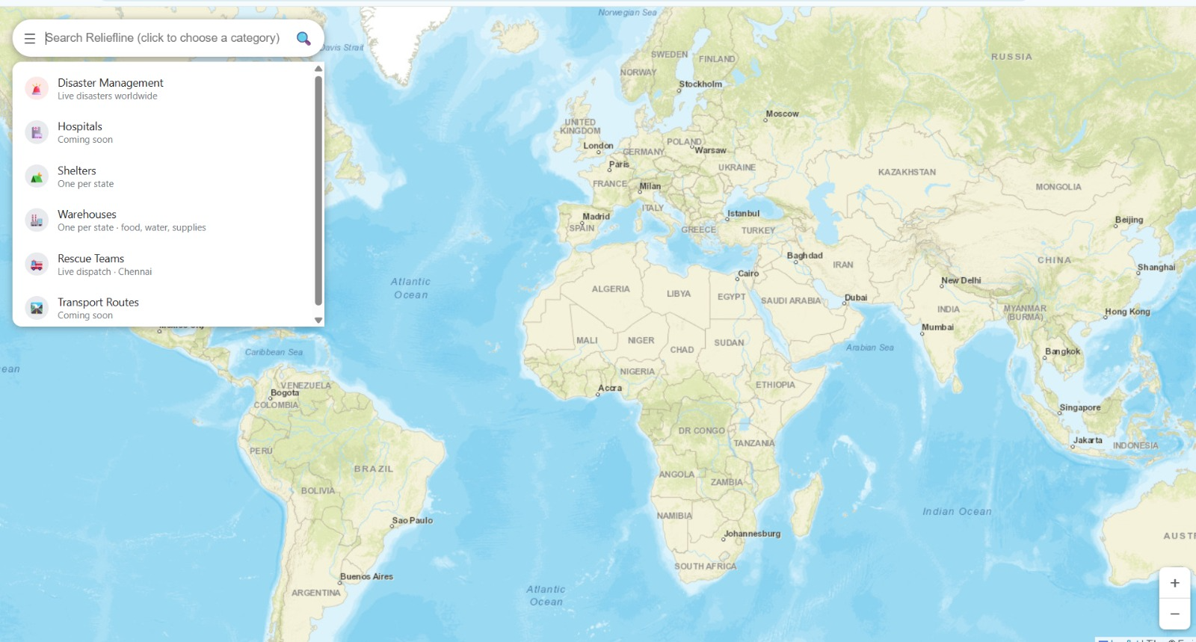
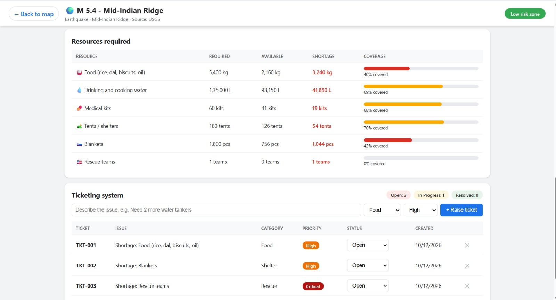
Output

Slide 12
Literature & Documentation
References
[1] Kuhn, H. W. (1955). The Hungarian method for the assignment problem. Naval Research Logistics Quarterly, 2(1–2), 83–97.
[2] Munkres, J. (1957). Algorithms for the assignment and transportation problems. J. SIAM, 5(1), 32–38.
[3] Özdamar, L., Ekinci, E., & Küçükyazici, B. (2004). Emergency logistics planning in natural disasters. Annals of Operations Research, 129, 217–245.
[4] Sheu, J.-B. (2007). An emergency logistics distribution approach for quick response to urgent relief demand in disasters. Transportation Research Part E, 43(6), 687–709.
[5] Altay, N., & Green, W. G. (2006). OR/MS research in disaster operations management. European Journal of Operational Research, 175(1), 475–493.
[6] Galindo, G., & Batta, R. (2013). Review of recent developments in OR/MS research in disaster operations management. European Journal of Operational Research, 230(2), 201–211.
[7] Sinnott, R. W. (1984). Virtues of the haversine. Sky and Telescope, 68(2), 159.
[8] Agafonkin, V. Leaflet: an open-source JavaScript library for interactive maps. https://leafletjs.com
[9] FastAPI documentation. https://fastapi.tiangolo.com

